Slide 1
Generative Adversarial Networks (GAN)
Michael(Mike) Erlihson, Ph.D.
ITC May (2020)

Slide 2
Agenda
GANs Applications
So how do GANs work
GAN Loss Function
GANs types and architectures
GANs Shortcomings

Slide 3
What is GAN
Type of neural network architecture that allow neural networks to generate data.
Recently GANs became one of the hottest subfields in deep learning
Generating fuzzy images of digits to photorealistic images of faces

Slide 4
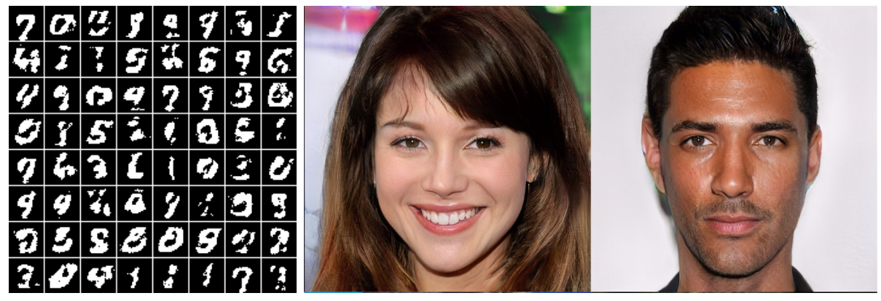
What GANs are able to generate?

Slide 5
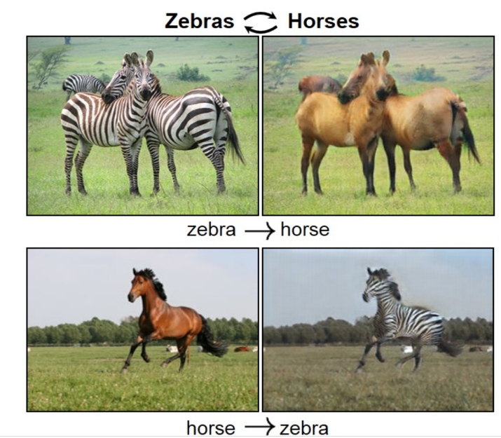
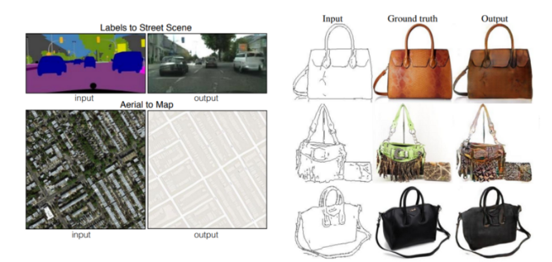
More advanced GAN capabilities:

Slide 6
GANs Basics
Learn dataset probability distribution via training two neural networks against each other.
Solve two problems simultaneously:
Discrimination - distinguish between real and fake images)
“Realistic” fake data generation - construct samples similar to real
These tasks are complete opposites - what would occur if we split them into different models: Generator vs. Discriminator?
Notes:
Another example: https://www.microsoft.com/developerblog/2016/09/13/training-a-classifier-for-relation-extraction-from-medical-literature/

Slide 7
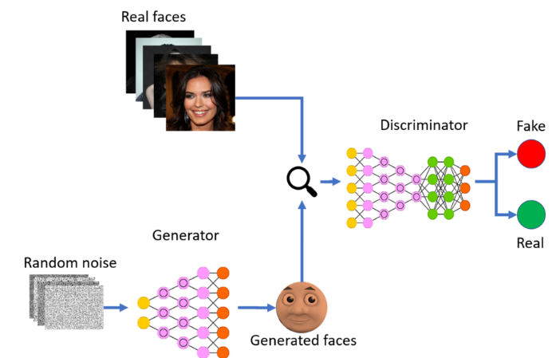
GAN Architecture: Basic Scheme

Slide 8
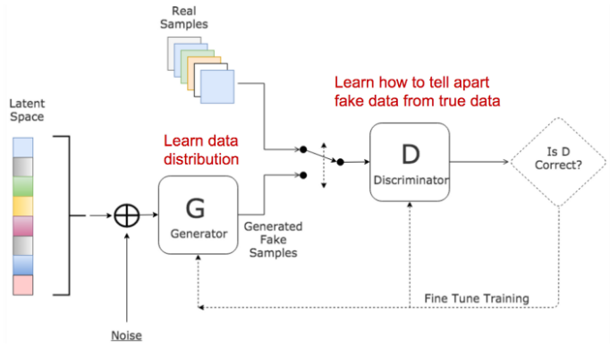
GAN Architecture: An essence
Generator(painting forger): tries to create images looking very similar to dataset
Discriminator(police)- tries to detect whether generated images were fake or not.

Slide 9
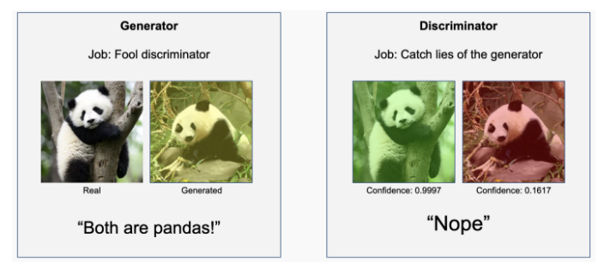
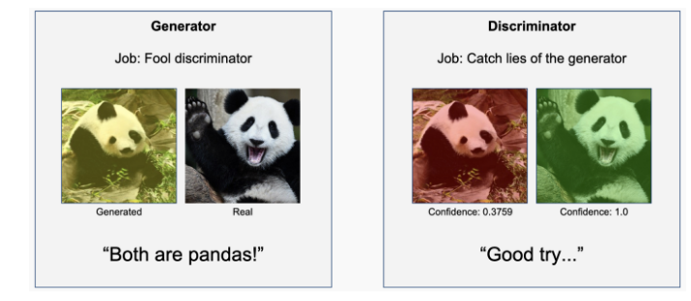
GAN Architecture: Training
Beginning of training
Later training stage

Slide 10
GAN Architecture: Training Process
Generator(forger) is improving in creating fakes, while discriminator(police) keep getting better at detecting fakes.
These two models keep competing with each other during the training process
Goal: produce two networks that are each as good as they can be: we don’t end up with a “winner”
Finally the generator “learns” to create images “indistinguishable” from the real dataset

Slide 11
Training Procedure: Details
Generator network takes as input a N-dimensional random noise and produces a fake image
Discriminator network input is both fake samples as well as samples from the dataset
Generator Training Goal: maximise D’s final classification error.
The generated images are perceived as real
Discriminator Training Goal: minimise the final classification error.
Real data is correctly distinguished from fake data
Makes binary decision about whether image z, is a real image D(z)=1, or a fake image, D(z)=0.

Slide 12
Loss Function
Loss function should estimate the cumulative performance of the two networks?
Predictions on the dataset by the discriminator should be as close to 1 as possible, and on the generator to be as close to 0 as possible.
To achieve this, use the log-likelihood of D(x) and 1-D(z) in the objective function.
Notes:
https://cs230-stanford.github.io/pytorch-nlp.html

Slide 13
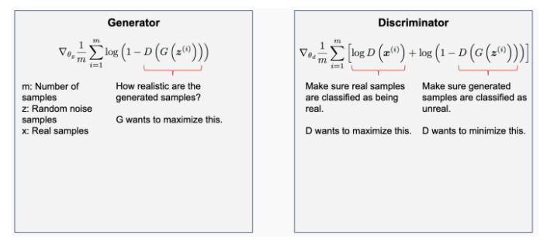
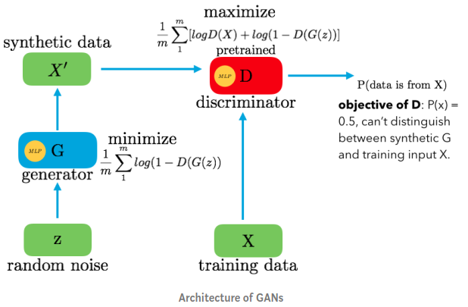
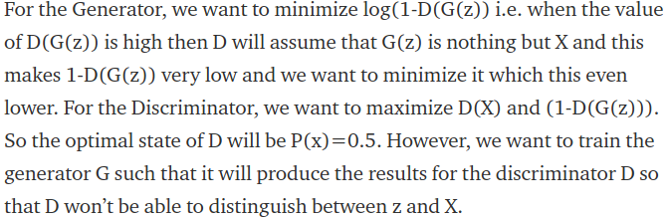
Loss Function: Intuition

Slide 14
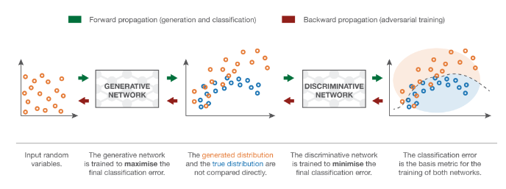
Training Procedure: Backpropagation:
To train the networks we perform backpropagation whilst freezing the other network’s neuron weights.
Generator’s weights are updated using Gradient Ascent to maximise the error, while Discriminator uses Gradient Descent to minimise it.
Notes:
https://towardsdatascience.com/deep-learning-for-ner-1-public-datasets-and-annotation-methods-8b1ad5e98caf

Slide 15
Training Procedure: Details
Perform several iterations of gradient descent on D using real and generated images by fixing G
Then fix D and train G for several iterations (usually more iterations required to train G) to fool a fixed D.
We want to optimize our minimax function by iterating both G and D in alternating steps until discriminator won’t be able to differentiate between real and fake images (D(x) = 0.5)
Notes:
https://cs230-stanford.github.io/pytorch-nlp.html#loading-the-text-data

Slide 16
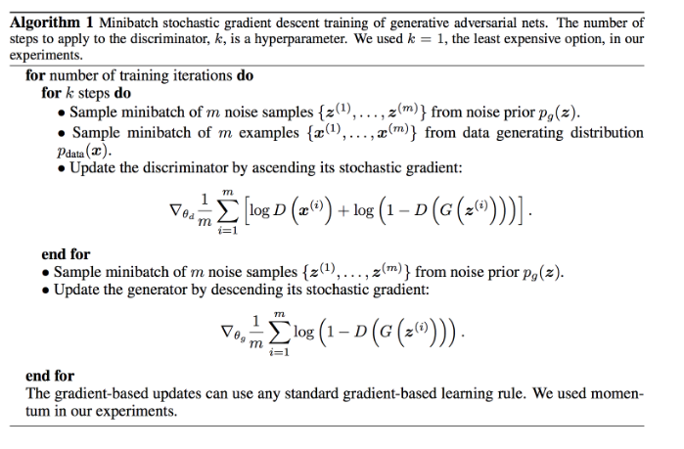
Training Procedure: Algorithm

Slide 17
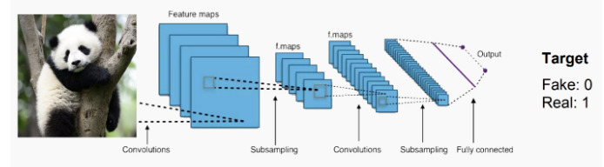
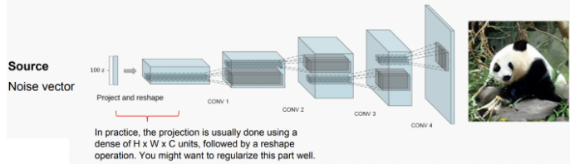
GANs Architectures: Basics
Discriminator
Generator

Slide 18
GANs Architectures: Advanced Considerations (DCGANs)
Replace Pooling with Strided convolutions (D learns its own spatial downsampling and G its respective upsampling without adding any bias)
Use BatchNorm (stabilizes learning by normalizing the input, creates more robust deep models without having the gradients diverging)
Avoid using Fully-Connected hidden layers (hurts convergence speed)
G: use ReLU and Tanh for the output. (tanh is preferred activation for images as an output as it has a range of [-1, 1])
D: use LeakyReLU (tested empirically, works well for modelling to a higher resolution)

Slide 19
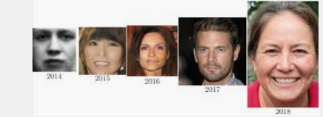
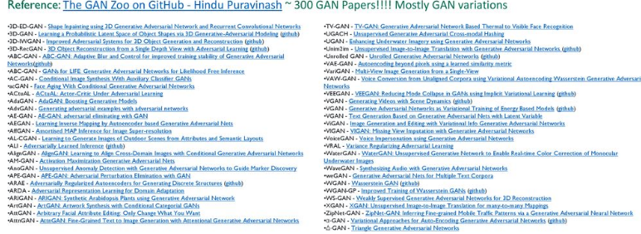
GANs Evolution and Flavours
GANs keeps improving!!
GAN’s Jungle is thriving!!

Slide 20
Famous GANs Types:
Conditional GANs: generate images given their features (labels)
Use extra label information and are able to control how generated images will look.
Learn to produce better images by exploiting the information fed to the model
Info GAN: information-theoretic extension.
Learn disentangled representations in an unsupervised manner.
Used for very complex datasets
Train cGAN for unlabeled datasets to extract the most important images feature
Cycle GAN: unpaired image to image translation.
Transforms an image from one domain (zebras images), to another (horses images)
Other image features( not directly related to either domain as background) stays recognizably the same

Slide 21
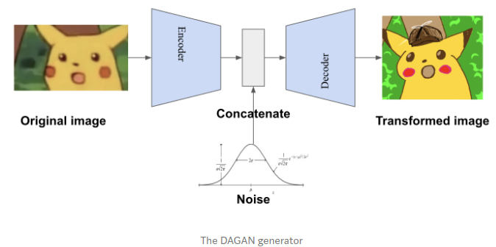
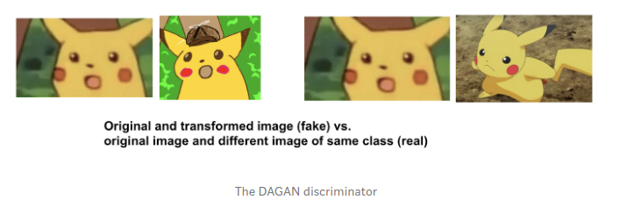
Cool GAN types: DaGAN(data augmentation)
Generates a synthetic image using a lower-dim representation of a real image(autoencoder style)
Takes an existing image, encodes it, adds noise, and decodes it.
Decoder learns a large family of transformations for data augmentation.

Slide 22
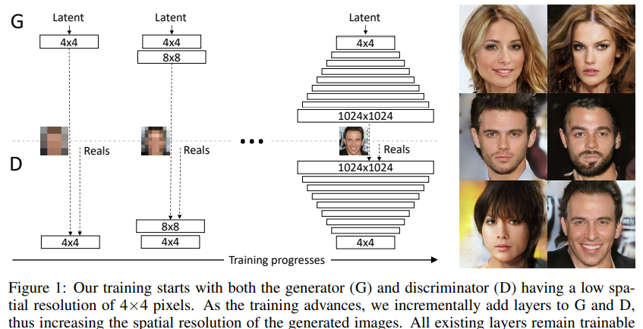
Cool GAN types: ProGAN (progressive)
Grows generator and discriminator progressively:
Starts from a low resolution, adds new layers modeling increasingly finer details while training progresses
Capable to generate high-quality images compared to its predecessors

Slide 23
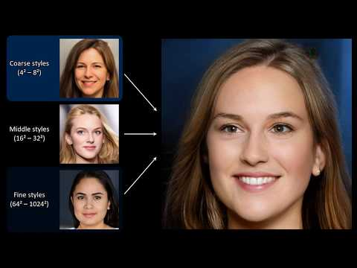
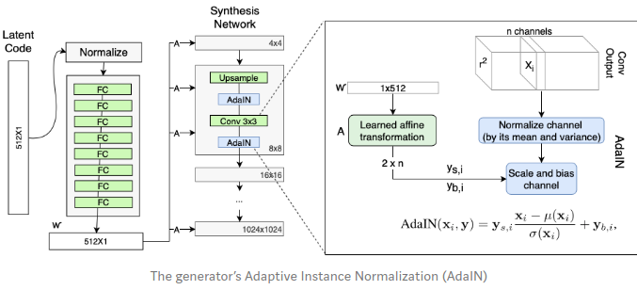
Cool GAN types: StyleGAN
Control visual features of the generated images, such as hair color, pose, nose form etc
Exploits ProGAN progressive layers’ ability to control image visual features, if utilized properly
The lower the layer (the resolution), the coarser the features it affects
Coarse - affects pose, general hair style, face shape, etc
Middle - affects finer facial features, hair style, eyes open/closed, etc.
Fine - affects color scheme (eye, hair and skin) and micro features.
N Btypes: ProGAN (progressive)

Slide 24
GANs shortcomings(1)
Sensitivity to both structure and parameters
If either the discriminator or generator gets better than the other too quickly, the other will never be able to catch up.
Finding the right combination can be very challenging
Convergence - No proof that GANs converge.
GANs perform well with the right parameters, but there’s no guarantee beyond that.
The more complicated network gets, the tougher convergence becomes, the more difficult hyperparameter selection becomes.

Slide 25
GANs shortcomings(2)
Generation of high-resolution big size images (partially solved by ProGANs but still…)
It’s easy for “D” to tell the generated fakes from the real images
Many pixels can lead to error gradients that cause the Gs output to move in almost random directions
Mode(modal) Collapse: “G” produces the same image every time independently of input noise (InfoGAN solves this issue partially)
When training our network, the “G” somehow finds one image that fools the “D”
“D” will always say it is real, so the “G” has accomplished its goal and stops learning.
However, the problem is that every sample made by the generator is identical.

Slide 26
Further readings about GANs
Brief introduction to GANs
Brief Introduction to GAN 2
Comprehensive GAN analysis with code
Generating dogs images with GANs(tensorflow)
How to Measure GAN Performance
GANs Flaws
GANs type (with some a bit advanced math)
StyleGAN: thorough analysis and examples
GANs for Data Augmentation
Ask the lecturer for more cool GAN Stuff

